Slide 1
Data Structures Recap

Slide 2
Announcements
Reduced Afternoon Office Hours Today (3:15-3:50pm)
HW 1 assigned

Slide 3
Data Structures
Data Structures
Linear
Direct Access
Sequential Access
Nonlinear
Hierarchical
Array
Linked List
Stack
Queue
Hashtable
Tree
Heap
Non-Hierarchical
Set
Graph
A scheme for organizing related data items.

Slide 4
Arrays
Good Uses?
All elements accessible in O(1)
When sorted allows for binary search
Fixed capacity
O(n) to transfer to a new array
Basis for strings – std ops often modified
0x1234 | 0x1235 | 0x1236 | 0x1237 | 0x1238 | 0x1239 | 0x123A | 0x123B
7 | 8 | 11 | 14 | 17 | 22 | 35 | 71
[0] | [1] | [2] | [3] | [4] | [5] | [6] | [7]
Notes:
Python has lists as closest equivalent

Slide 5
Linked Lists
Sequentially accessible: O(n)
Adjustable capacity
Efficient insertion at head
Can be extended to a doubly-linked list
7
8
11
14
Head
NULL
Notes:
Basis for stack/queue. Largely supplanted by vector as standalone data structure.

Slide 6
How Do Stacks & Queues Differ?

Slide 7
Stacks: LIFO
top
12
Push: add item to top
Pop: remove item from top
Extremely efficient: O(1)
Essential for recursive algorithms (call stack)
9
18
25
Good Uses?

Slide 8
Python Data Structures
Stacks
Use append() and pop() with a list
pythons = []
pythons.append("Terry")
pythons.append("Eric")
pythons.append("John")
pythons.append("Michael")
pythons.append("Graham")
while(len(pythons) > 0):
print(pythons.pop())

Slide 9
Queues: FIFO
Enqueue: add an item to the rear
Dequeue: remove an item from front
Extremely efficient: O(1)
Great for implementing “fair” sequencing
Good Uses?
14
3
22
front
rear

Slide 10
Python Data Structures
Queues
Import deque type (double-ended list)
Use append() and popleft()
from collections import deque
def main():
pythons = deque([])
pythons.append("John")
pythons.append("Graham")
while(len(pythons) > 0):
print(pythons.popleft())

Slide 11
Priority Queues
Can be implemented using array or list structure
Best implemented using a heap (chapter 6)
Good Uses?
20
9
9
4
1
food
TV
HW
call home
clean room
front

Slide 12
Hashtables
Good Uses?
Maps keys to data.
Great for lookup
Efficient, but needs good hash function, good key, enough space
[0]
[1]
[2]
[3]
[4]
[5]
[6]
[7]
Bob 1235 3.0
Andy 1011 3.2
Carl 2222 3.95

Slide 13
Python Data Structures
Dictionary: maps keys to data
cast = {"Chapman": "Arthur", "Cleese": "Lancelot"}
cast["Palin"] = "Galahad"
cast["Idle"] = "Robin"
print(cast["Cleese"])
print(cast.keys())
for key in cast.keys():
print(key, ": ", cast[key])
if "Palin" in cast:
print("Michael Palin was in the cast.")

Slide 14
Python Data Structures
Can loop through keys and vals together:
cast = {"Chapman": "Arthur", "Cleese": "Lancelot"", "Palin": "Galahad"", "Idle": "Robin"}
for key, value in cast.items():
print(key, " maps to ", value)

Slide 15
Sets
Unordered collection with no duplicates
Described by listing or specifying property (list comprehension in Python)
Common ops: check membership, union, intersection
Efficiently implemented with hashtables.
Good Uses?

Slide 16
Python Data Structures
Sets: unordered collection with no duplicates
Use { } instead of [ ]
Use membership operators (in / not in)
set() can create a set from a string or list
add() and remove()
menu = {"spam", "eggs", "spam", "spam", "sausage", "bacon", "spam", "eggs", "spam"}
print(menu)
# prints {‘bacon’, ‘spam’, ‘sausage’ ‘eggs’}
if "spam" in menu:
print("This must be a Monty-Python-run cafe!")

Slide 17
Python Data Structures
Sets: unordered collection with no duplicates
Standard mathematical set operations available
a = set("monty python")
b = set("parrot sketch")
print(a&b) # conjunction: in both a and b
print(a|b) # disjunction: in either a or b or both
print(a-b) # set difference: in a but not in b
print(a^b) # xor

Slide 18
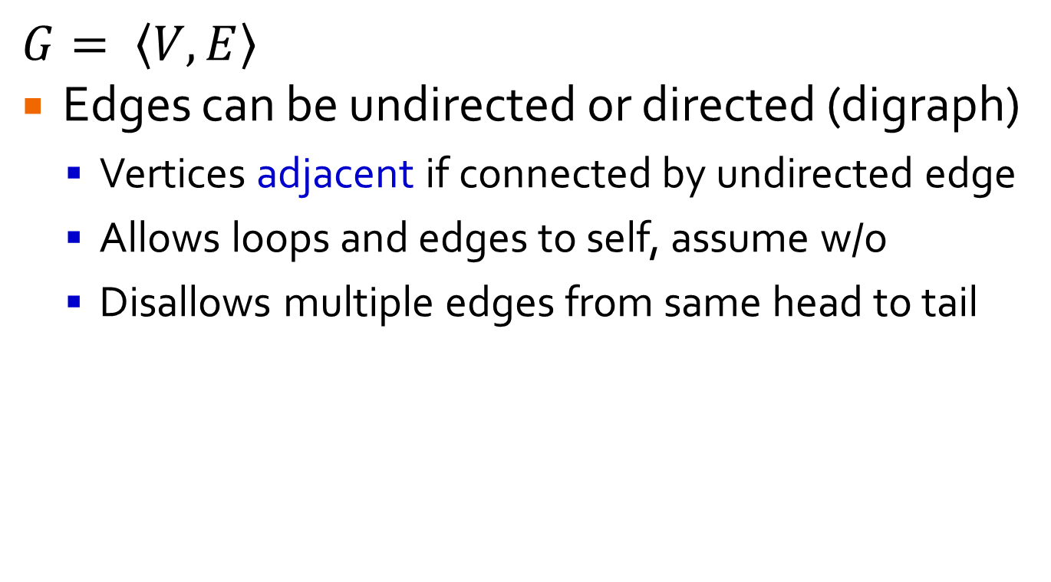
Graphs
$$G= \left\langle V,E\right\rangle$$
Edges can be undirected or directed (digraph)
Vertices adjacent if connected by undirected edge
Allows loops and edges to self, assume w/o
Disallows multiple edges from same head to tail
a
b
c
a
b
c
d
e
f
d
e
f

Slide 19
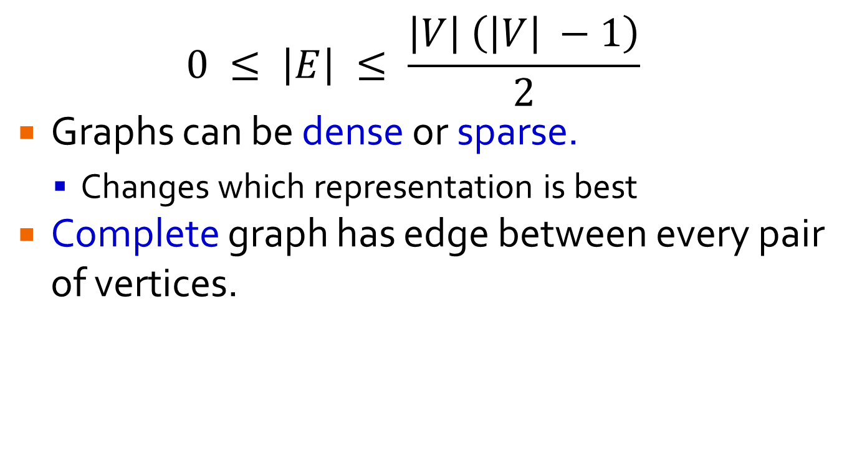
Graphs
$$0 ≤ \left|E\right| ≤ \frac{\left|V\right| \left(\left|V\right| −1\right)}{2}$$
Graphs can be dense or sparse.
Changes which representation is best
Complete graph has edge between every pair of vertices.
a
b
c
a
b
c
d
e
f
d
e
f

Slide 20
Graph Representations
Adjacency Matrix: good for dense graphs
Adjacency List: good for sparse graphs
a
b
c
d
e
f
 | a | b | c | d | e | f
a | 0 | 1 | 0 | 0 | 0 | 0
b | 0 | 0 | 0 | 0 | 1 | 0
c | 0 | 1 | 0 | 0 | 0 | 1
d | 1 | 0 | 0 | 0 | 1 | 0
e | 0 | 1 | 0 | 0 | 0 | 1
f | 0 | 0 | 0 | 0 | 0 | 0
a | → | b
b | → | e
c | → | b | → | f
d | → | a | → | e
e | → | b | → | f
f
Best representation varies with problem being solved.
Edges can be weighted.
Notes:
Infinite cost for edges that don’t exist.

Slide 21
Graph Properties
A path from u to v is a sequence of adjacent vertices that starts with u and ends with v.
Path is simple if no vertices are repeated.
Length of path is number of vertices – 1.
Comparable definition for digraphs.
Example: (simple) path from a to f? length?
a
b
c
d
e
f

Slide 22
Graph Properties
A graph is connected if there is a path between every pair of vertices, u and v.
Graphs that are not connected contain connected components which are maximal connected subgraphs.
a
b
c
d
e
f

Slide 23
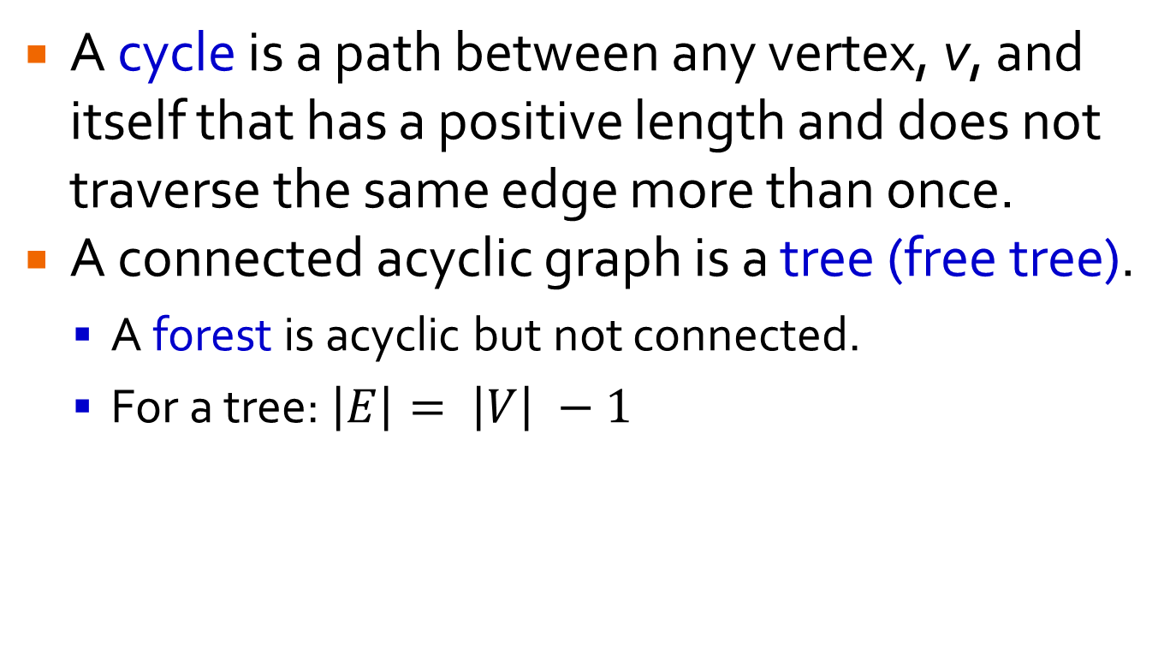
Graph Properties
A cycle is a path between any vertex, v, and itself that has a positive length and does not traverse the same edge more than once.
A connected acyclic graph is a tree (free tree).
A forest is acyclic but not connected.
For a tree: $\left|E\right|= \left|V\right| −1$
a
b
c
a
b
c
d
e
f
d
e
f

Slide 24
Trees
Always 1 simple path between any 2 vertices
A rooted tree is much more common in CS.
Used for hierarchies, file directories, org charts, efficient access to large data sets (Ch. 7), data encoding (Ch. 9), backtracking, branch & bound (Ch. 12).
b
a
c
a
b
c
d
f
d
e
f
e

Slide 25
Rooted Trees
Give rise to terminology: parent, child, ancestor, descendent, subtree
Height of tree is length of longest simple path from root to leaf.
Depth of vertex, v, is length of simple path from root to v.
b
a
c
d
f
e

Slide 26
Binary Trees
No more than 2 children, ordered left & right.
Works well with recursion.
34
19
50
1
21
46
87

Slide 27

Binary Search Trees
Searchable in height of tree: $\left\lfloor \log_{2}{n}\right\rfloor ≤h≤n−1$
Example of multiway search tree.
34
19
50
1
21
46
87

Slide 28
Remaining Time …
Start HW 1

